Slide 1
Entity Authentication
.

Slide 2
14.1 INTRODUCTION
Entity authentication is a technique designed to let one party prove the identity of another party.
An entity can be a person, a process, a client, or a server.
The entity whose identity needs to be proved is called the claimant;
the party that tries to prove the identity of the claimant is called the verifier.
When Bob tries to prove the identity of Alice, Alice is the claimant, and Bob is the verifier.
.

Slide 3
Data-Origin Versus Entity Authentication
There are two differences between message authentication (data-origin authentication), and entity authentication.
Message authentication (or data-origin authentication) might not happen in real time; entity authentication does. In the former, Alice sends a message to Bob. When Bob authenticates the message, Alice may or may not be present in the communication process. On the other hand, when Alice requests entity authentication, there is no real message communication involved until Alice is authenticated by Bob. Alice needs to be online and to take part in the process. Only after she is authenticated can messages be communicated between Alice and Bob. Data-origin authentication is required when an email is sent from Alice to Bob. Entity authentication is required when Alice gets cash from an automatic teller machine.
Second, message authentication simply authenticates one message; the process needs to be repeated for each new message. Entity authentication authenticates the claimant for the entire duration of a session.
.

Slide 4
Verification Categories
In entity authentication, the claimant must identify herself to the verifier.
3 kinds of witnesses: something known, something possessed, or something inherent.
❏ Something known. This is a secret known only by the claimant that can be checked by the verifier. Examples are a password, a PIN, a secret key, and a private key.
❏ Something possessed. This is something that can prove the claimant’s identity. Examples are a passport, a driver’s license, an identification card, a credit card, and a smart card.
❏ Something inherent. This is an inherent characteristic of the claimant. Examples are conventional signatures, fingerprints, voice, facial characteristics, retinal pattern, and handwriting.
.

Slide 5
Entity Authentication and Key Management
This chapter discusses entity authentication.
The next chapter discusses key managment.
These two topics are very closely related; most key management protocols use entity authentication protocols.
.

Slide 6
14.2 PASSWORDS
The simplest and oldest method of entity authentication is the password-based
authentication, where the password is something that the claimant knows.
A password is used when a user needs to access a system to use the system’s resources (login).
Each user has a user identification that is public, and a password that is private.
We can divide these authentication schemes into two groups:
the fixed password and
The one-time password.
.

Slide 7
14.2 PASSWORDS
Fixed Password
A fixed password is a password that is used over and over again for every access.
Several schemes have been built, one upon the other.
First Approach
In the very rudimentary approach, the system keeps a table (a file) that is sorted by user identification.
To access the system resources, the user sends her user identification and password, in plaintext, to the system.
The system uses the identification to find the password in the table.
If the password sent by the user matches the password in the table, access is granted; otherwise, it is denied.
.

Slide 8
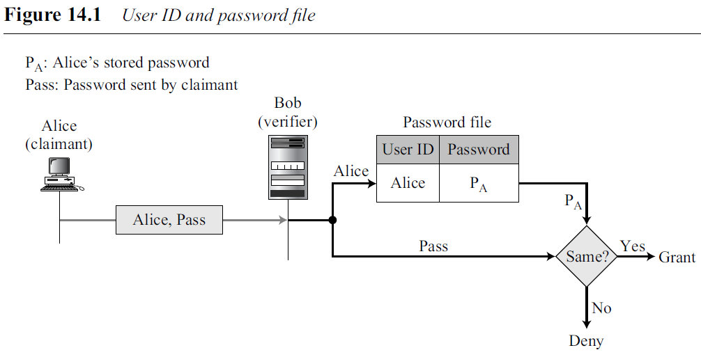
14.2 PASSWORDS
First Approach
.

Slide 9
14.2 PASSWORDS
Attacks on the First Approach This approach is subject to several kinds of attack.
❏ Eavesdropping. Eve can watch Alice when she types her password. Eavesdropping can take a more sophisticated form. Eve can listen to the line and intercept the message, thereby capturing the password for her own use.
❏ Stealing a password. The second type of attack occurs when Eve tries to physically steal Alice’s password. This can be prevented if Alice does not write down the password.
.

Slide 10
14.2 PASSWORDS
First Approach
Accessing a password file.
Eve can hack into the system and get access to the ID/ password file.
Eve can read the file and find Alice’s password or even change it.
To prevent this type of attack, the file can be read/write protected.
However, most systems need this type of file to be readable by the public.
Guessing.
Using a guessing attack, Eve can log into the system and try to guess Alice’s password by trying different combinations of characters.
Particularly vulnerable if the user is allowed to choose a short password.
Vulnerable if something trivial, such as her birthday, her child’s name etc.
To prevent guessing, a long random password is recommended.
However, the use of such a random password may also create a problem.
Because she could easily forget such a password, Alice might store a copy of it somewhere, which makes the password subject to stealing.
.

Slide 11
14.2 PASSWORDS
Second Approach
A more secure approach is to store the hash of the password in the password file.
Any user can read the contents of the file, but, because the hash function is a one-way function, it is almost impossible to guess the value of the password.
When the password is created, the system hashes it and stores the hash in the password file.
.

Slide 12
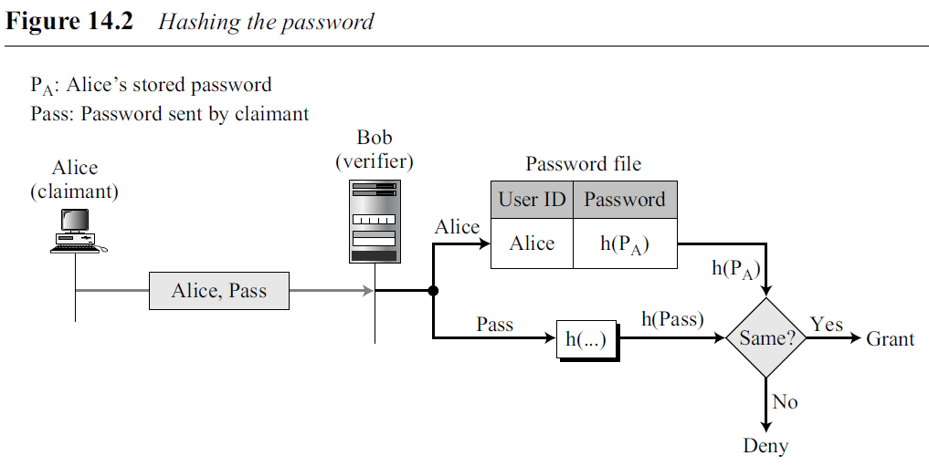
14.2 PASSWORDS
Second Approach
When the user sends the ID and the password, the system creates a hash of the password and then compares the hash value with the one stored in the file. If there is a
match, the user is granted access; otherwise, access is denied. In this case, the file does not need to be read protected.
.

Slide 13
14.2 PASSWORDS
Dictionary Attack
In this attack, Eve is interested in finding one password, regardless of the user ID. For example, if the password is 6 digits, Eve can create a list of 6-digit numbers (000000 to 999999), and then apply the hash function to every number; the result is a list of one million hashes.
Then get the password file and search the second-column entries to find a match.
This could be programmed and run offline on Eve’s private computer.
The third approach shows how to make this attack more difficult.
.

Slide 14
14.2 PASSWORDS
Third Approach
Called salting the password.
When the password string is created, a random string, called the salt, is concatenated to the password.
The salted password is then hashed. The ID, the salt, and the hash are then stored in the file.
Now, when a user asks for access, the system extracts the salt, concatenates it with the received password, makes a hash out of the result, and compares it with the hash stored in the file.
If there is a match, access is granted; otherwise, it is denied.
.

Slide 15
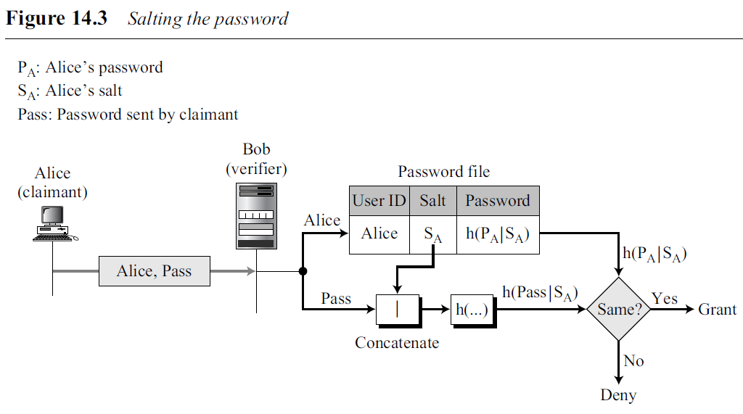
14.2 PASSWORDS
Third Approach
.

Slide 16
14.2 PASSWORDS
Salting makes the dictionary attack more difficult.
If the original password is 6 digits and the salt is 4 digits, then hashing is done over a 10-digit value.
This means that Eve now needs to make a list of 10 million items and create a hash for each of them.
The list of hashes has 10 million entries, and the comparison takes much longer.
Salting is very effective if the salt is a very long random number.
The UNIX operating system uses a variation of this method.
.

Slide 17
14.2 PASSWORDS
Fourth Approach
In the fourth approach, two identification techniques are combined.
Example : Use of an ATM card with a PIN (personal identification number).
Card belongs to the category “something possessed ” and the PIN belongs to the category “something known”.
The PIN is a password that enhances the security of the card.
If the card is stolen, it cannot be used unless the PIN is known.
PIN number is traditionally very short so it is easily remembered by the owner.
This makes it vulnerable to the guessing type of attack.
.

Slide 18
One-Time Password
A one-time password is a password that is used only once.
This kind of password makes eavesdropping and salting useless.
First Approach
The user and the system agree upon a list of passwords.
Each password on the list can be used only once.
There are some drawbacks to this approach.
First, the system and the user must keep a long list of passwords.
Second, if the user does not use the passwords in sequence, the system needs to perform a long search to find the match.
The password is valid only once and cannot be used again.
.

Slide 19
Second Approach
User and the system agree to sequentially update the password.
The user and the system agree on an original password, P1, which is valid only for the first access.
During the first access, the user generates a new password, P2, and encrypts this password with P1 as the key.
P2 is the password for the second access.
During the second access, the user generates a new password, P3, and encrypts it with P2; P3 is used for the third access.
In other words, Pi is used to create Pi+1.
Of course, if Eve can guess the first password (P1), she can find all of the subsequent ones.
.

Slide 20
Third Approach
User and the system create a sequentially updated password using a hash function (devised by Leslie Lamport. )
User and the system agree upon an original password, P₀, and a counter, n.
The system calculates h^{n}(P₀), where h^{n} means applying a hash function n times. In other words,
System stores the identity of Alice, the value of n, and the value of h^{n}(P₀).
.

Slide 21
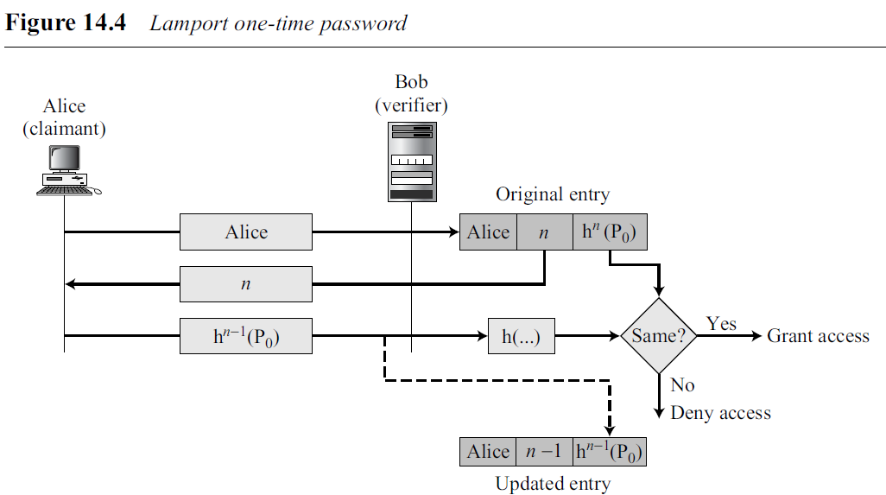
Third Approach (contd)
Figure 14.4 shows how the user accesses the system the first time.
.

Slide 22
14.3 CHALLENGE-RESPONSE
In password authentication, the claimant proves her identity by demonstrating that she knows a secret, the password.
However, because the claimant reveals this secret, it is susceptible to interception by the adversary.
In challenge-response authentication, the claimant proves that she knows a secret without sending it.
In other words, the claimant does not send the secret to the verifier; the verifier either has it or finds it.
.

Slide 23
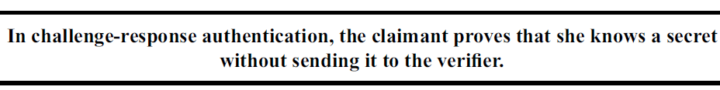
14.3 CHALLENGE-RESPONSE
.

Slide 24
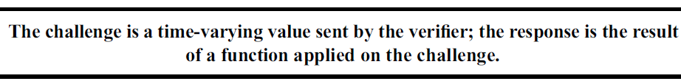
14.3 CHALLENGE-RESPONSE
The challenge is a time-varying value such as a random number or a timestamp that is sent by the verifier.
The claimant applies a function to the challenge and sends the result, called a response, to the verifier.
The response shows that the claimant knows the secret.
.

Slide 25
14.3 CHALLENGE-RESPONSE
Using a Symmetric-Key Cipher
Several approaches to challenge-response authentication use symmetric-key encryption.
Secret here is the shared secret key, known by both the claimant and the verifier.
The function is the encrypting algorithm applied on the challenge.
First Approach
The verifier sends a nonce, a random number used only once, to challenge the claimant.
A nonce must be time-varying; every time it is created, it is different.
The claimant responds to the challenge using the secret key shared between the claimant and the verifier.
.

Slide 26
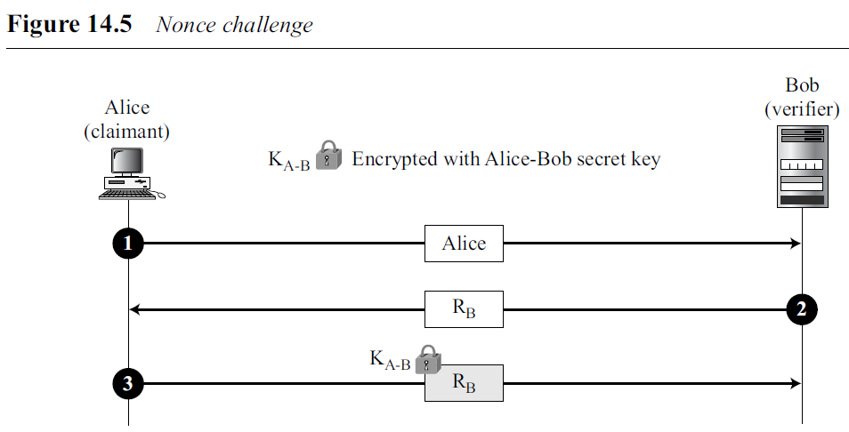
14.3 CHALLENGE-RESPONSE
First Approach
The first message is not part of challenge-response, it only informs the verifier that the claimant wants to be challenged.
The second message is the challenge. R_{B} is the nonce randomly chosen by the verifier (Bob) to challenge the claimant.
The claimant encrypts the nonce using the shared secret key known only to the claimant and the verifier and sends the result to the verifier.
The verifier decrypts the message. If the nonce obtained from decryption is the same as the one sent by the verifier, Alice is granted access.
.

Slide 27
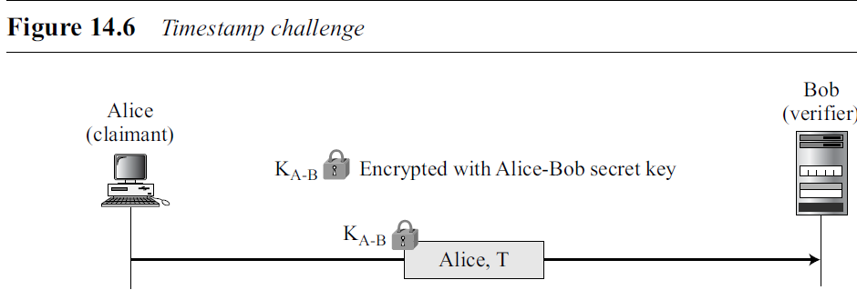
14.3 CHALLENGE-RESPONSE
Second Approach
The time-varying value is a timestamp, which obviously changes with time.
In this approach the challenge message is the current time sent from the verifier to the claimant.
However, this supposes that the client and the server clocks are synchronized; the claimant knows the current time.
This means that there is no need for the challenge message.
.

Slide 28
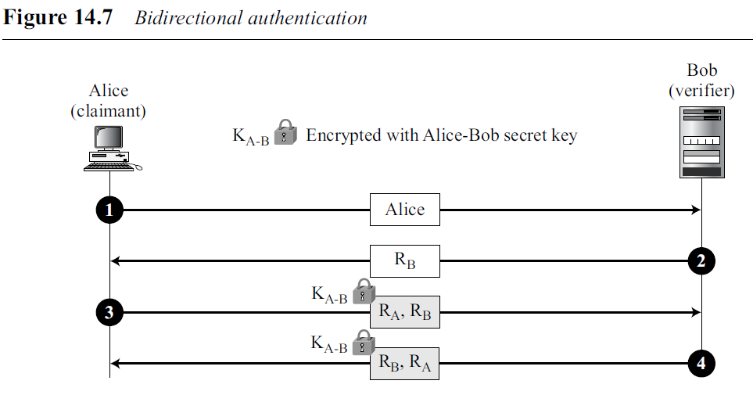
14.3 CHALLENGE-RESPONSE
Third Approach
The first and second approaches are for unidirectional authentication.
Alice is authenticated to Bob, but not the other way around.
If Alice also needs to be sure about Bob’s identity, we need bidirectional authentication.
.

Slide 29
14.3 CHALLENGE-RESPONSE
Third Approach
The second message R_{B} is the challenge from Bob to Alice.
In the third message, Alice responds to Bob’s challenge and at the same time, sends her challenge R_{A} to Bob.
The fourth message is Bob’s response. In the fourth message the order of R_{A} and R_{B} are switched to prevent a replay attack of the third message by an adversary.
.

Slide 30
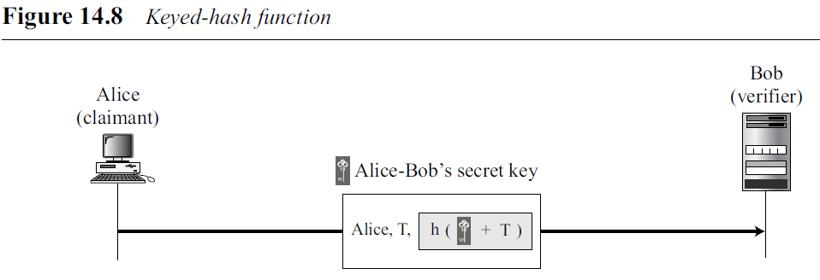
14.3 CHALLENGE-RESPONSE
Using Keyed-Hash Functions
Using a keyed-hash function (MAC).
Advantage: It preserves the integrity of challenge and response messages and at the same time uses a secret, the key.
Figure : Using a keyed-hash function to create a challenge response with a timestamp.
In this case, the timestamp is sent both as plaintext and as text scrambled by the keyed-hash function.
When Bob receives the message, he takes the plaintext T, applies the keyed-hash function, and then compares his calculation with what he received to determine the authenticity of Alice.
.

Slide 31
14.3 CHALLENGE-RESPONSE
Using an Asymmetric-Key Cipher
Here the secret must be the private key of the claimant.
The claimant must show that she owns the private key related to the public key that is available to everyone.
This means that the verifier must encrypt the challenge using the public key of the claimant; the claimant then decrypts the message using her private key.
The response to the challenge is the decrypted challenge.
Following are two approaches: one for unidirectional authentication and one for bidirectional authentication.
.

Slide 32
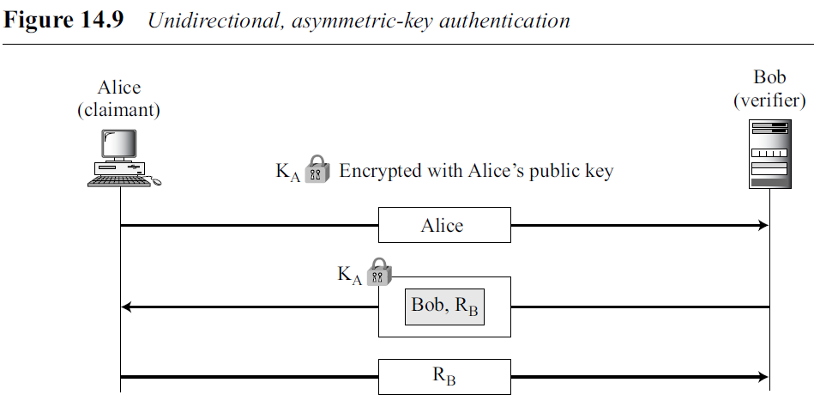
14.3 CHALLENGE-RESPONSE
Using an Asymmetric-Key Cipher
First Approach
In the first approach, Bob encrypts the challenge using Alice’s public key. Alice decrypts the message with her private key and sends the nonce to Bob.
.

Slide 33
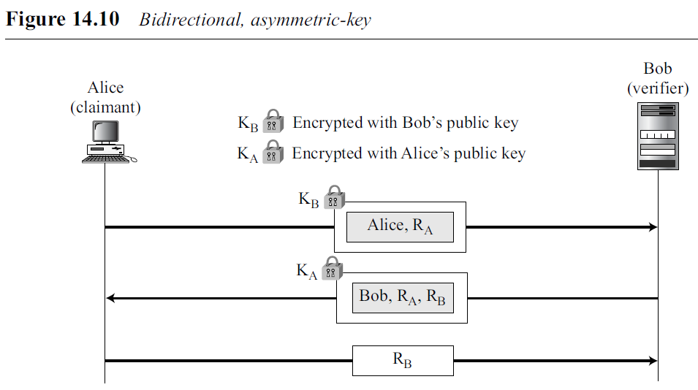
14.3 CHALLENGE-RESPONSE
Using an Asymmetric-Key Cipher
Second Approach
In the second approach, two public keys are used, one in each direction.
Alice sends her identity and nonce encrypted with Bob’s public key.
Bob responds with his nonce encrypted with Alice’s public key.
Finally, Alice, responds with Bob’s decrypted nonce.
.

Slide 34
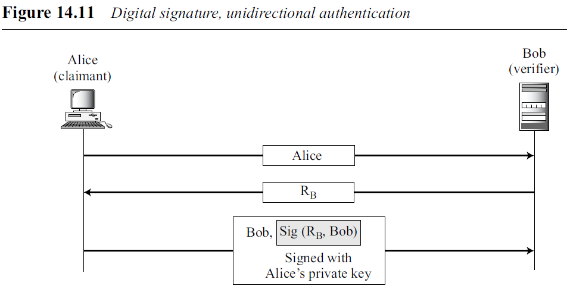
14.3 CHALLENGE-RESPONSE
Using Digital Signature
When a digital signature is used for entity authentication, the claimant uses her private key for signing.
Two approaches are:
First Approach
In the first approach, Bob uses a plaintext challenge and Alice signs the response.
.

Slide 35
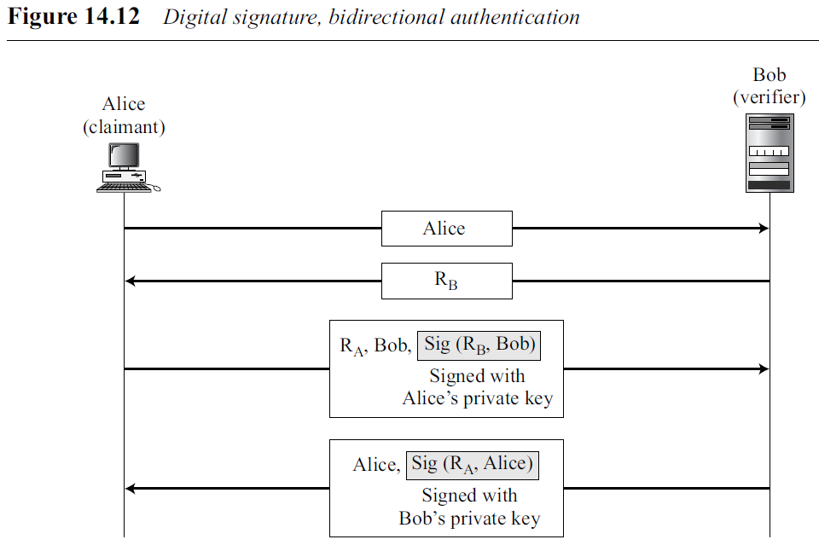
14.3 CHALLENGE-RESPONSE
Using Digital Signature
Second Approach
In the second approach, Alice and Bob authenticate each other.
.

Slide 36
14.4 ZERO-KNOWLEDGE
In password authentication,
claimant needs to send her secret (the password) to the verifier;
subject to eavesdropping by Eve.
dishonest verifier could reveal the password to others.
In challenge-response entity authentication,
claimant’s secret is not sent to the verifier.
claimant applies a function on the challenge sent by the verifier that includes her secret.
In some challenge-response methods, the verifier actually knows the claimant’s secret, which could be misused by a dishonest verifier.
In other methods, the verifier can extract some information about the secret from the claimant by choosing a preplanned set of challenges.
.

Slide 37
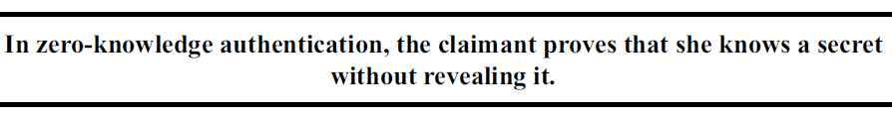
14.4 ZERO-KNOWLEDGE
In zero-knowledge authentication, the claimant does not reveal anything that might endanger the confidentiality of the secret.
The claimant proves to the verifier that she knows a secret, without revealing it.
The interactions are so designed that they cannot lead to revealing or guessing the secret.
After exchanging messages, the verifier only knows that the claimant does or does not have the secret, nothing more.
The result is a yes/no situation, just a single bit of information.
.

Slide 38
Fiat-Shamir Protocol
In this, a trusted third party chooses two large prime numbers p and q to calculate the value of n = p × q.
The value of n is announced to the public; the values of p and q are kept secret.
Alice, the claimant, chooses a secret number s between 1 and n − 1 (exclusive).
She calculates v = s² mod n.
She keeps s as her private key and registers v as her public key with the third party.
.

Slide 39
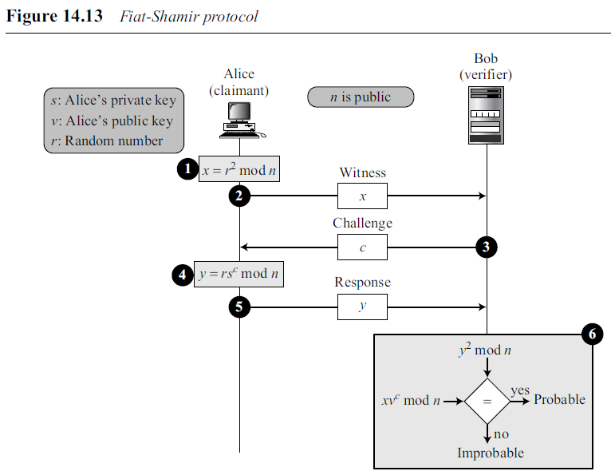
Fiat-Shamir Protocol
Verification of Alice by Bob can be done in four steps.
s between 1 and n-1
v = s² mod n.
r between 0 and n − 1
.

Slide 40

Fiat-Shamir Protocol
Alice, the claimant, chooses a random number r between 0 and n − 1 (r is called the commitment). She then calculates the value of x = r² mod n; x is called the witness.
2. Alice sends x to Bob as the witness.
3. Bob, the verifier, sends the challenge c to Alice. The value of c is either 0 or 1.
4. Alice calculates the response y = rs^{c}. Note that r is the random number selected by Alice in the first step, s is her private key, and c is the challenge (0 or 1).
5. Alice sends the response to Bob to show that she knows the value of her private key, s. She claims to be Alice.
6. Bob calculates y² and xv^{c}. If these two values are congruent, then Alice either knows the value of s (she is honest) or she has calculated the value of y in some other ways (dishonest) because we can easily prove that y² is the same as xv^{c} in modulo n arithmetic as shown below:
.

Slide 41
Fiat-Shamir Protocol
The six steps constitute a round;
The verification is repeated several times with the value of c equal to 0 or 1 (chosen randomly).
The claimant must pass the test in each round to be verified.
If she fails one single round, the process is aborted and she is not authenticated.
.

Slide 42
Fiat-Shamir Protocol
Elaboration:
Alice can be honest (knows the value of s) or dishonest (does not know the value of s).
If she is honest, she passes each round.
If she is not, she still can pass a round by predicting the value of challenge correctly.
Two situations can happen:
.

Slide 43
Fiat-Shamir Protocol
1. Alice guesses that the value of c (the challenge) will be 1 (a prediction). She calculates x = r²/v and sends x as the witness.
If her guess is correct (c turned out to be 1), she sends y = r as the response. We can see that she passes the test (y² = xv^{c}).
b. If her guess is wrong (c turned out to be 0), she cannot find a value of y that passes the test. She probably quits or sends a value that does not pass the test and Bob will abort the process.
.

Slide 44
Fiat-Shamir Protocol
2. Alice guesses that the value of c (challenge) will be 0. She calculates x = r² and sends x as the witness.
c. If her guess is correct (c turned out to be 0), she sends y = r as the response. We can see that she passes the test (y² = xv^{c}).
d. If her guess is wrong (c turned out to be 1), she cannot find a value of y that passes the rest. She probably quits or sends a value that does not pass the test and Bob will abort the process.
.

Slide 45
Fiat-Shamir Protocol
We can see that a dishonest claimant has a 50 percent chance of fooling the verifier and passing the test (by predicting the value of the challenge).
In other words, Bob assigns a probability of 1/2 to each round of the test.
If the process is repeated 20 times, the probability decreases to (1/2)²⁰ or 9.54 × 10⁻⁷.
In other words, it is highly improbable that Alice can guess correctly 20 times.
.

Slide 46
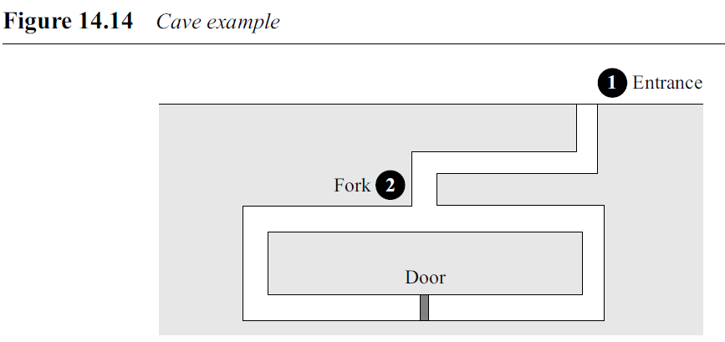
Cave Example To show the logic behind the above protocol, Quisquater and Guillou devised the cave example
.

Slide 47
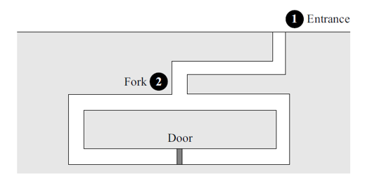
Suppose there is an underground cave with a door at the end of the cave that can only be opened with a magic word.
Alice claims that she knows the word and that she can open the door. At the beginning, Alice and Bob are standing at the entrance (point 1).
Alice enters the cave and reaches the fork (point 2).
Bob cannot see Alice from the entrance. Now the game starts.
1. Alice chooses to go either right or left. This corresponds to the sending of the witness (x).
2. After Alice disappears into the cave, Bob comes to the fork (point 2) and asks Alice to come up from either the right or left. This corresponds to sending the challenge (c).
.

Slide 48
3. If Alice knows the magic word (her private key), she can come up from the requested side. She may have to use the magic word (if she is on the wrong side) or she can just come up without using the magic word (if she is at the right side). However, if Alice does not know the magic word, she may come up from the correct side if she has guessed Bob’s challenge. With a probability of 1/2, Alice can fool Bob and make him believe that she knows the magic word. This corresponds to the response (y).
4. The game is repeated many times. Alice will win if she passes the test all of the time. The probability that she wins the game is very low if she does not know the magic word. In other words, P = (1/2)^{N} where P is the probability of winning without knowing the magic word and N is the number of times the test is run.
.

Slide 49
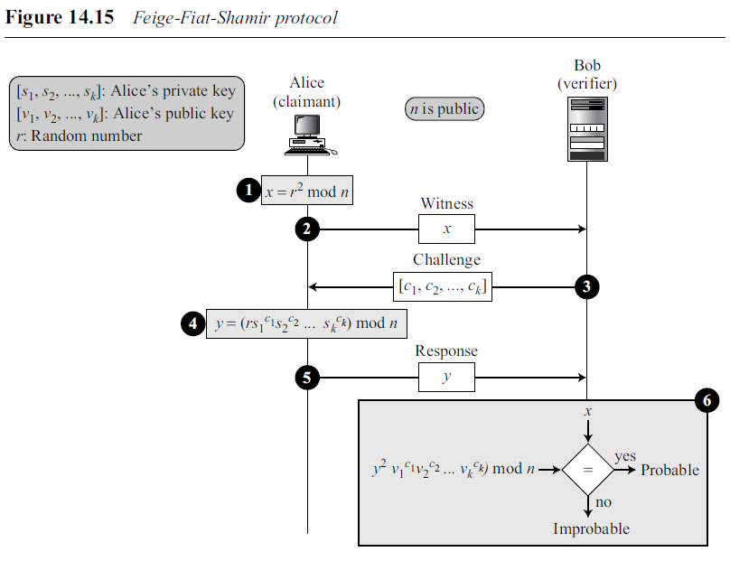
Feige-Fiat-Shamir Protocol
Feige-Fiat-Shamir protocol is similar to the first approach except that it uses a vector of private keys [s₁, s₂, …, s_{k}], a vector of public keys [v₁, v₂, …, v_{k}], and a vector of challenges (c₁, c₂, …, c_{k}).
The private keys are chosen randomly, but they must be relatively prime to n.
The public keys are chosen such that v_{i} = (s_{i} ²)⁻¹ mod n.
.

Slide 50
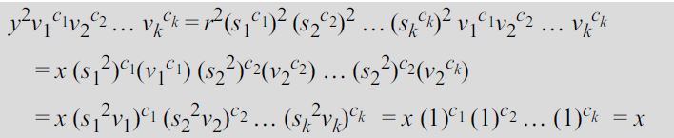
Feige-Fiat-Shamir Protocol
We can prove that y²v₁^{c1}v₂^{c2} … v_{k}^{ck} is the same as x:
The three exchanges constitute a round; verification is repeated several times with the value of c’s equal to 0 or 1 (chosen randomly).
The claimant must pass the test in each round to be verified.
If she fails a single round, the process is aborted and she is not authenticated.
.

Slide 51
Guillou-Quisquater Protocol
Is an extension of the Fiat-Shamir protocol in which fewer number of rounds can be used to prove the identity of the claimant.
A trusted 3rd party chooses two large prime numbers p and q to calculate the value of n = p × q.
Trusted party also chooses an exponent, e, which is coprime with φ, where φ = (p − 1)(q − 1).
The values of n and e are announced to the public; the values of p and q are kept secret.
The trusted party chooses two numbers for each entity, v which is public and s which is secret. However, in this case, the relationship between v and s is different: s^{e} × v = 1 mod n.
The three exchanges constitute a round;
verification is repeated several times with a random value of c (challenge) between 1 and e.
The claimant must pass the test in each round to be verified. If she fails a single round, the process is aborted and she is not authenticated.
.

Slide 52
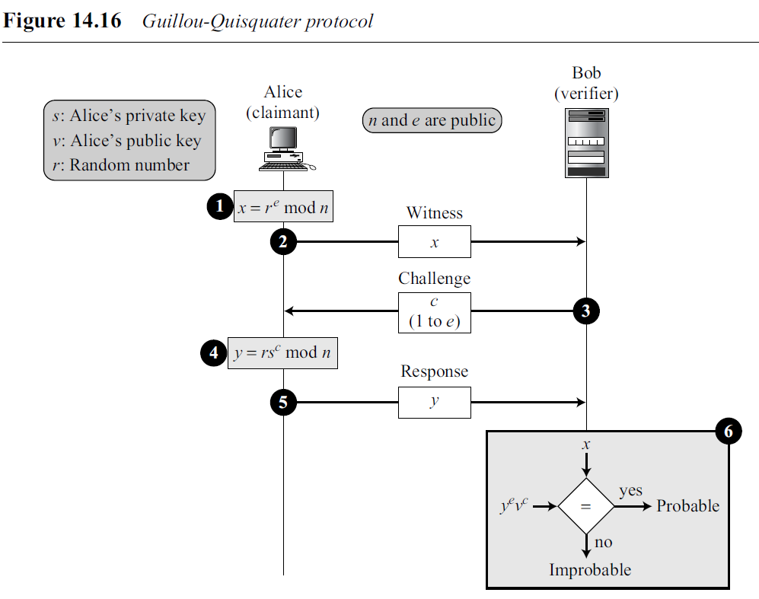
Guillou-Quisquater Protocol
Figure 14.16 shows one round.
The equality can be proven as shown below:
.

Slide 53
14.5 BIOMETRICS
Biometrics is the measurement of physiological or behavioral features that identify a person (authentication by something inherent).
Biometrics measures features that cannot be guessed, stolen, or shared.
Components
Capturing devices such as readers (or sensors) measure biometrics features.
Processors change the measured features to the type of data appropriate for saving.
Storage Devices save the result of processing for authentication.
Enrollment
Before using any biometric techniques for authentication, the corresponding feature of each person should be available in the database. This is referred to as enrolment.
.

Slide 54
Authentication
Authentication is done by verification or identification.
Verification
In verification, a person’s feature is matched against a single record in the database (one-to-one matching) to find if she is who she is claiming to be.
When a bank needs to verify a customer’s signature on a check.
Identification
In identification, a person’s feature is matched against all records in the database (one-to-many matching) to find if she has a record in the database.
When a company needs to allow access to the building only to employees.
.

Slide 55
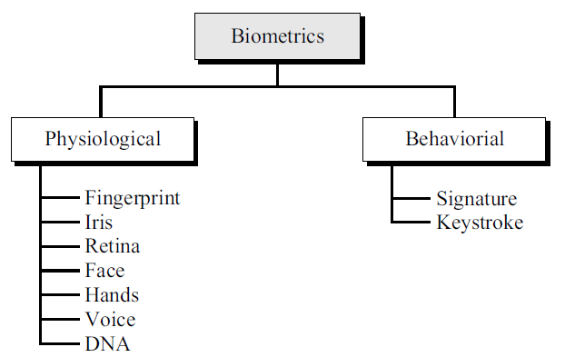
Techniques
Two broad categories of biometric techniques are physiological and behavioral.
Several common techniques under each category.
.

Slide 56
Physiological Techniques
Measure the physical traits of the human body for verification and identification.
To be effective, the trait should be unique among all or most of the population.
Feature should be changeable due to aging, surgery, illness, disease, and so on.
There are several physiological techniques.
.

Slide 57
Fingerprint
Two most common are minutiae-based and image-based.
minutiae-based technique : System creates a graph based on where individual ridges start/stop or branch.
Image-based technique : System creates an image of the fingertip and finds similarities to the image in the database.
High level of accuracy and support verification and identification.
However, fingerprints can be altered by aging, injury, or diseases.
Iris
This technique measures the pattern within the iris that is unique for each person.
It normally requires a laser beam (infrared).
They are very accurate and stable over a person’s life.
They also support verification and identification.
However, some eye diseases, such as cataracts, can alter the iris pattern.
.

Slide 58
Retina
The devices for this purpose examine the blood vessels in the back of the eyes.
However, these devices are expensive and not common yet.
Face
Analyzes the geometry of the face based on the distance between facial features such as the nose, mouth, and eyes.
Standard video cameras and this technique support both verification and identification.
However, accuracy can be affected by eyeglasses, growing facial hair, and aging.
Hands
Measures the dimension of hands, including the shape and length of the fingers.
This technique can be used indoors and outdoors.
However, it is better suited to verification rather than identification.
.

Slide 59
Voice
Voice recognition measures pitch, cadence, and tone in the voice.
It can be used locally (microphone) or remotely (audio channel).
This method is mostly used for verification.
However, accuracy can be diminished by background noise, illness, or age.
DNA
DNA is the chemical found in the nucleus of all cells of humans and most other organsims.
The pattern is persistent throughout life and even after death.
It is extremely accurate.
It can be used for both verification and identification.
The only problem is that identical twins may share the same DNA.
.

Slide 60
Behavioral Techniques
Behavioral techniques measure some human behavior traits.
Behavioral techniques need to be monitored to ensure the claimant behaves normally and does not attempt to impersonate someone else.
Signature
signatures were used in the banking industry to verify the identity of the check writer.
Biometric approaches use signature tablets and special pens to identify the person.
These devices not only compare the signature, they also measure some other behavioral traits, such as the timing needed to write the signature.
Signatures are mostly used for verification.
Keystroke
The keystrokes (typing rhythm) technique measures the behavior of a person related to working with a keyboard.
It can measure the duration of key depression, the time between keystrokes, number and frequency of errors, the pressure on the keys, and so on.
It is inexpensive because it does not require new equipment.
However, it is not very accurate because the trait can change with time (people become faster or slower typists). It is also text dependent.
.

Slide 61
Accuracy
Accuracy of biometric techniques is measured using two parameters: false rejection rate (FRR) and false acceptance rate (FAR).
False Rejection Rate (FRR)
This parameter measures how often a person, who should be recognized, is not recognized by the system.
FRR is measured as the ratio of false rejection to the total number of attempts (in percentage).
False Acceptance Rate (FAR)
This parameter measures how often a person, who should not be recognized, is recognized by the system.
FAR is measured as the ratio of false acceptance to the total number of attempts (in percentage).
.

Slide 62
Applications
Several applications of biometrics are already in use.
In commercial environments, these include access to facilities, access to information systems, transaction at point-of sales, and employee timekeeping.
In the law enforcement system, they include investigations (using fingerprints or DNA) and forensic analysis.
Border control and immigration control also use some biometric techniques.
.

Slide 63
END
.

